Slide 1
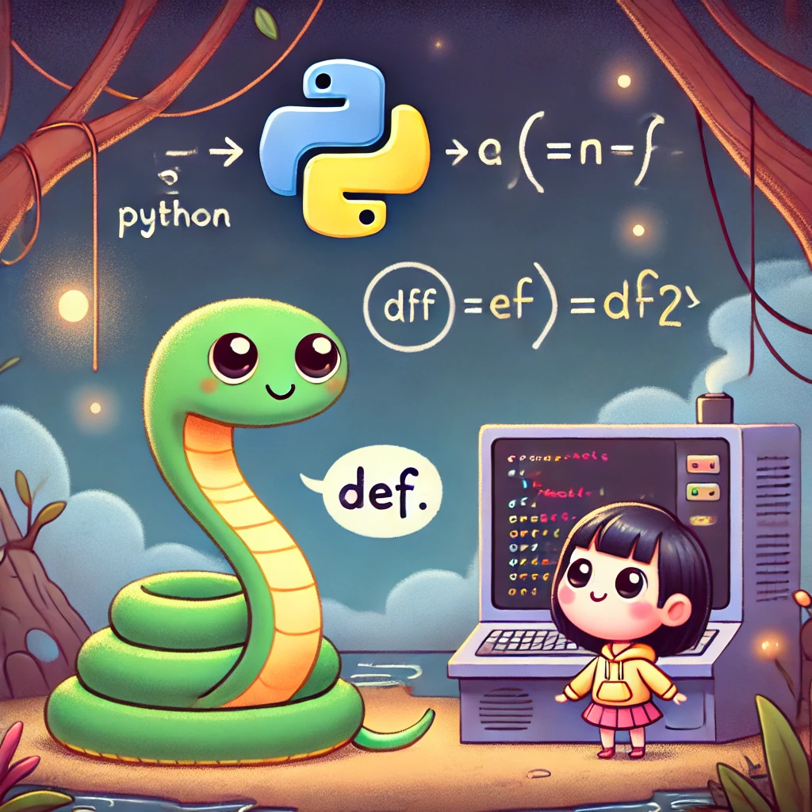
Week 3: Function definition Statements
Statements
Function Basics: def keyword
Parameters and Return Values
Function Calling and Execution Flow
Function Scope
Best Practices

Slide 2
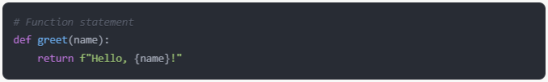
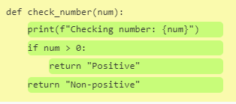
Function Basics - Definition
Syntax: def function_name(parameters):
Example:
Function statements include ALL nested statements
In other words, the function statement goes from the `d` in `def` all the way to the close-quotation mark (”) in “Non-positive”

Slide 3
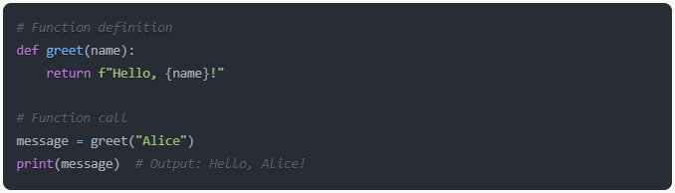
Calling 📞 Functions
Syntax: function_name(arguments):
Example:
“Alice” is the argument that corresponds to the parameter name
Function call greet(“Alice”) is an expression that resolves to a string

Slide 4
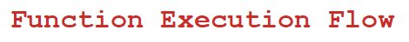
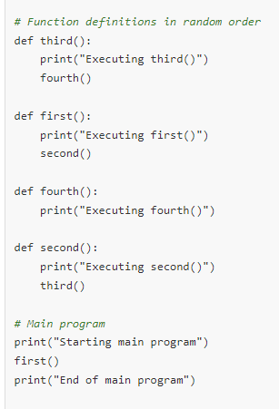
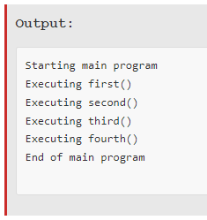
Function Execution Flow
Python reads scripts from top to bottom
When it encounters a function statement:
It registers the function’s location
It does NOT execute the function’s body
Function body only executes when the function is called
1st
2nd
3rd
4th

Slide 5
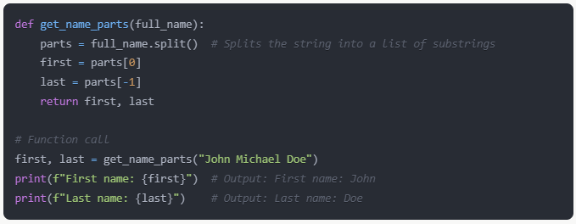
Function Parameters and Return Values
Parameters allow functions to work with different inputs
Return statements specify the output of a function
Multiple values can be returned if you want, just put a comma (,)
Example:

Slide 6
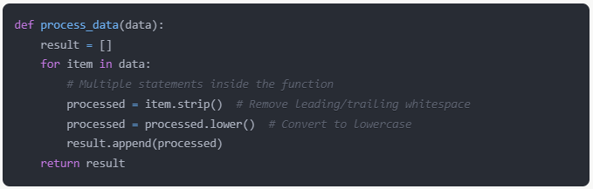
🐍 But why functions?? 🐍
Function statements encapsulate (group together) multiple statements
Functions promote code organization and readability
Example:

Slide 7
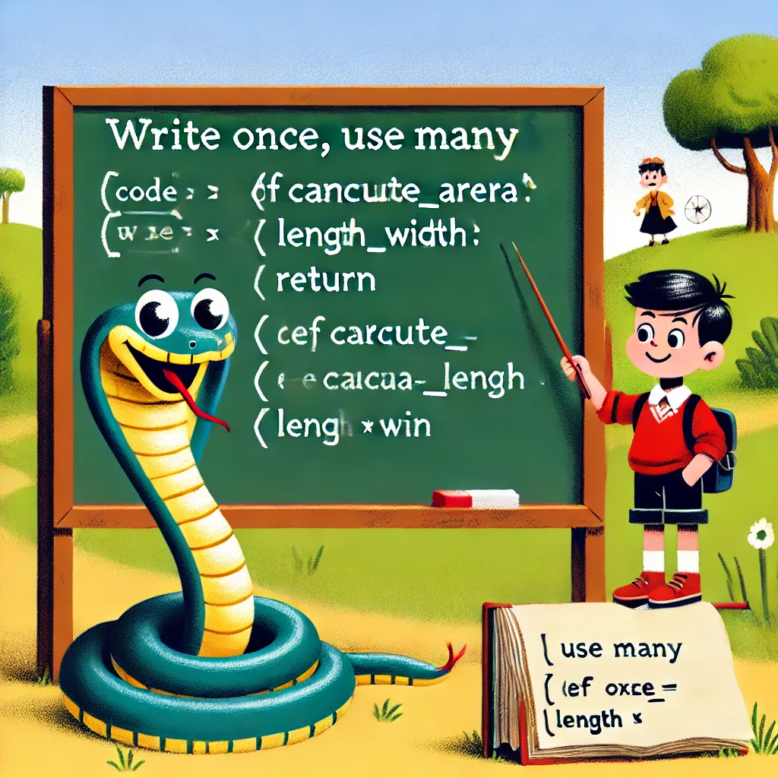
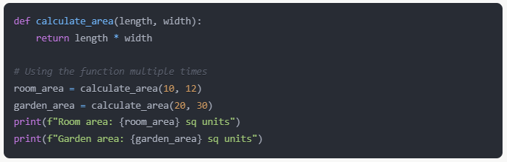
🐍 Code Reusability 🐍
Write once, use many times
Reduces code duplication
Improves maintainability of your programs
Example:

Slide 8
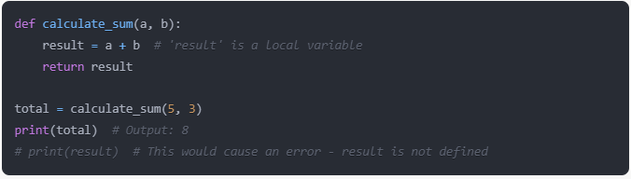
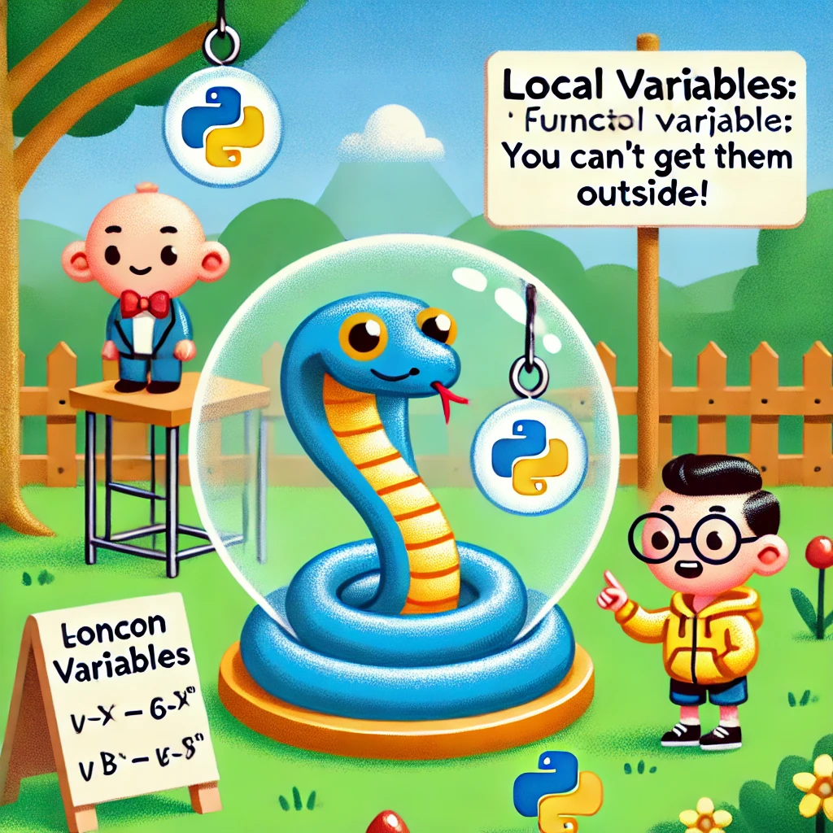
Function Scope
Variables defined inside the functions are local
Local variables are not accessible outside the function
Example:

Slide 9
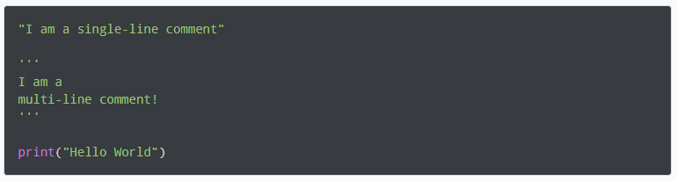
Best practices
Use descriptive names like: calculate_area()
Keep functions short and focused on a single task
Use comments (#) or docstrings (''' ''') to document complex functions
Docstring example:

Slide 10


